Slide 1



INTERPRETABLE
DATA

Slide 2

OVERVIEW
01
02
03
About
Our Team
Data Preprocessing
04
05
06
Our Models
Interpretable Approaches
Conclusion

Slide 3





ABOUT
DESCRIPTION
OVERVIEW
Our task is to refine a linear churn prediction model for a telecommunications company, ensuring it remains highly interpretable. The model's coefficients are crucial for enhancing customer retention strategies. Improve its accuracy while maintaining clear interpretability.
We compared the churn prediction models and presented our approaches to interpret these models

Slide 4


OUR TEAM
Anais Mellas
Anto Sibi Rayan
Praveen Subramani
Bharanidharan Murugesan

Slide 5





DATA PREPROCESSING
01
Checking Impurities & Handling Null
02
Ensuring the Data Types
03
Encoding Categorical variables to Binary since it is a classification problem
04
Feature Selection & Ready to model

Slide 6
HANDLING MULTICOLLINEARITY
Created new variable, no_customer_service_calls_interactions
ad_spend_per_day_of_usage
01
02
Dropped the columns, 'number_customer_service_calls', 'number_customer_service_interactions','ad_spend','total_usage','service_outage_reported'
03
Replaced infinity values in ad_spend_per_day_of_usage with Mean
04
Ran F-Score Feature Selection again

Slide 7

FEATURE SELECTION
BASED ON F SCORE
Subscription Tenure
Service Outages Count
Recent Renewal
Wifi Service Package
Current Discount
Daily Advertising Spend
International Calls Made
Phone Service Package
Southern Region
Global Calling Plan
Western Region
Northeastern Region
Voicemail Messages Count
Customer Service Interactions
Regional Economic Status

Slide 8
















Our Models
Accuracy
AUC
Logistic Regression Model
F1 Score
Accuracy
Decision Tree
AUC
F1 Score
Accuracy
AUC
KNN
F1 Score
Accuracy
Random Forest
AUC
F1 Score
Accuracy
AUC
Gradient Boosting
F1 Score

Slide 9




LOGISTIC REGRESSION
{HYPER PARAMETERS}
l1
Accuracy
AUC
F1
balanced
saga
{'classification__C',
'classification__class_weight',
'classification__penalty',
'classification__solver' ,
'feature_selection__n_features_to_select'}
0.8
10
PARAMETERS

Slide 10


INTERPRETABLE APPROACH

Slide 11

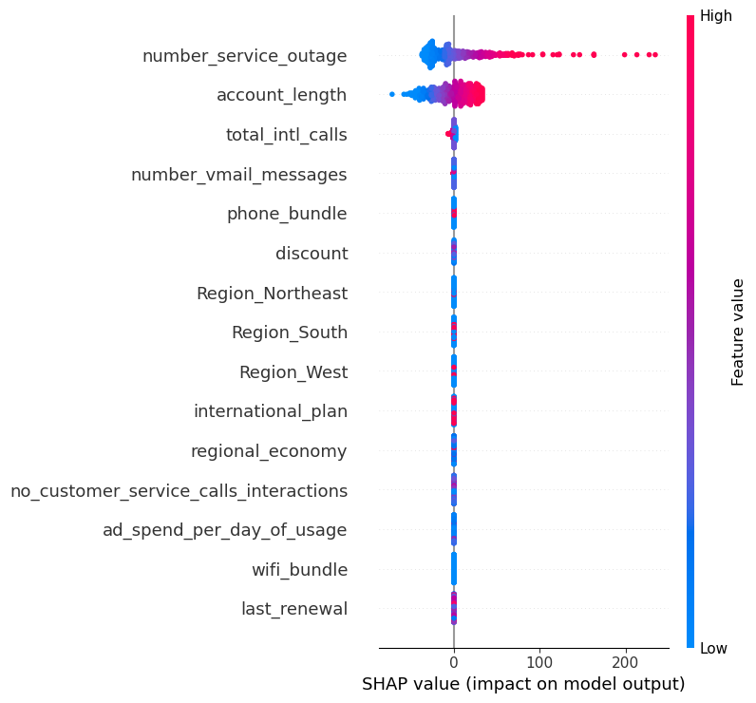

TOP 25% CHURN USING SHAP
Strategic Insights:
• The SHAP plot helps uncover key determinants of customer behavior and refine retention strategies, such as changing pricing or service offers depending on their expected influence on turnover.
Key Determinants:
• Account Length: Both short and lengthy durations affect churn chances.
• Service Outages: Significantly increase churn likelihood.
• Total Int'l Calls: Mixed effects on churn probability.
• Vmail Messages: Minimal impact on churn.
• Phone Bundle: Slightly increases churn risk.
Regional Influence:
• All regions moderately impact churn.
International Plan and Regional Economy have minimal influence.

Slide 12
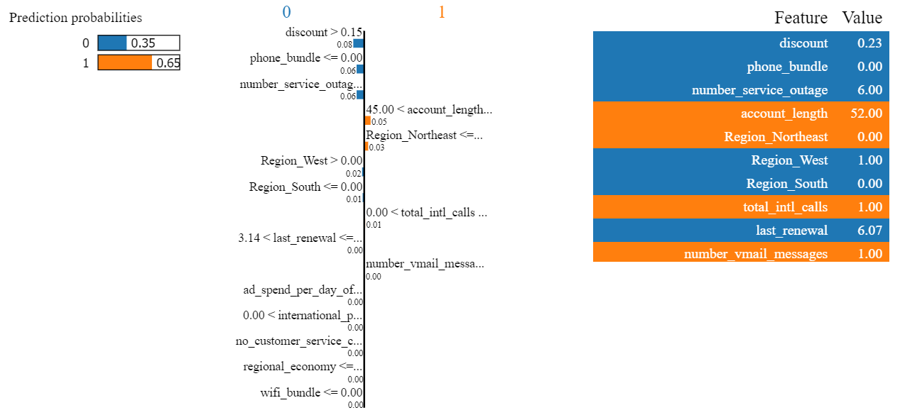
TOP 25% CHURN USING LIME
Prediction Probabilities: The model predicts two outcomes, 0 and 1. Outcome 0 has a probability of 0.35, while outcome 1 has a higher probability of 0.66.
Feature Influence: The features ‘discount’, ‘phone bundle’, and ‘number service outage’ have the most significant influence on the predicted outcomes. Higher values of ‘discount’ and ‘phone bundle’ increase the probability of outcome 1, while ‘number service outage’ has a minimal impact.
Value Contribution: Each feature contributes a certain value to the prediction probabilities. For instance, ‘discount’ contributes a value of 0.23 to outcome 1.

Slide 13
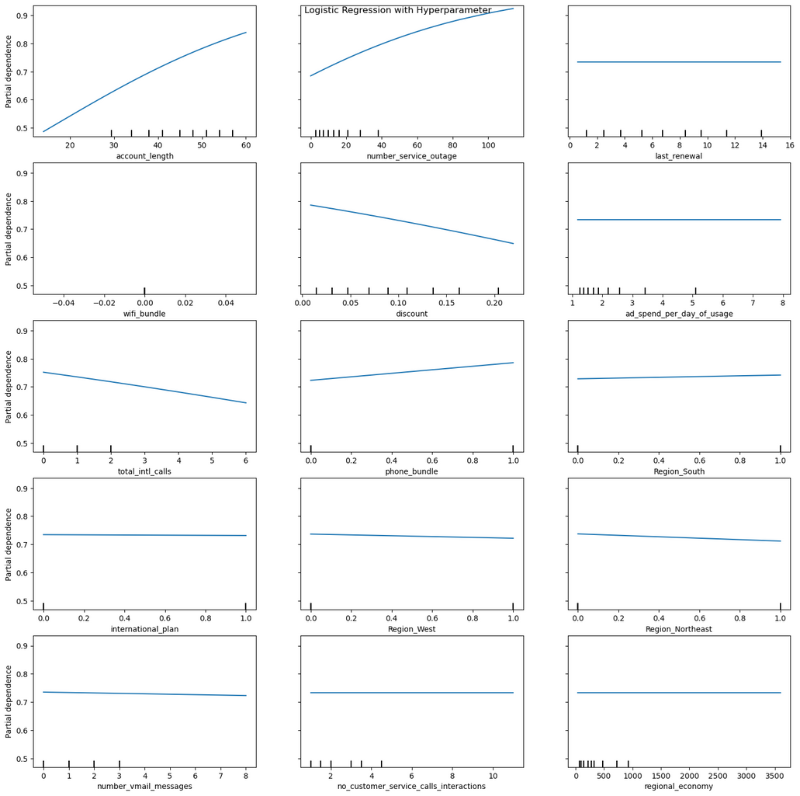
TOP 25% CHURN USING PDP
Account Length increases in account length leads to a higher probability of churn.
In Number of Service Outages, more outages result in a much higher churn probability showing a steep increase.
Wifi Bundle decreases in churn probability as the value of the wifi bundle increases.
Higher discounts lead to lower churn probabilities.
Lower ad spend is associated with higher churn probability, that is, it flattens as spend increases.
Higher number of international calls lowers the probability of churn.
There is a slight decrease in churn probability with increased phone bundle value.
Higher number of voicemail messages slightly decreases churn probability.
As for the number of Customer Service Calls Interactions, fewer interactions lead to lower churn probability.

Slide 14

Thank you

